Slide 1
Item-based Collaborative Filtering with BERT
Presented By:
Group No: 21
ID: 20266029
Name : Akash Chandra Das

Slide 2
Introduction:
Recommender systems
Traditional recommendation algorithms - Collaborative filtering-based - Content-based.
Item-based collaborative filtering( BERT MODEL)
Large-scale real-world dataset with full cold-start scenario.
Significantly outperforms the popular Bi-LSTM model.

Slide 3
Method ,Model,Dataset:
Collaborative Filtering with BERT
Model: -Next Purchase Prediction -Masked Language Model -Bi-LSTM Model (baseline)
Experments on a large-scale e-commerce Dataset -Training set -Validation set -Testing set

Slide 4
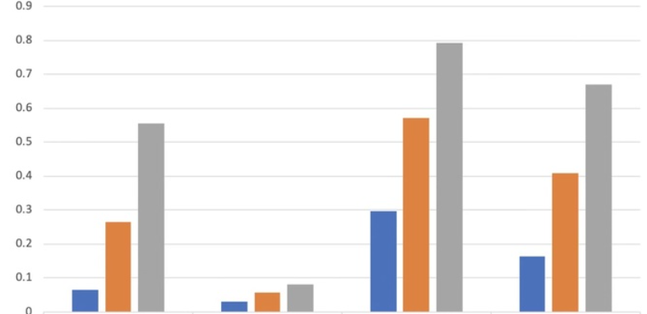
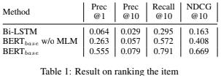
Experimental Results :
The proposed BERT model
greatly outperforms the LSTM-based model.
BERT model for item-based collaborative filtering is clear.
Adapting the token distribution for the e-commerce context with masked language model within BERT is essential for achieving the best performance.

Slide 5
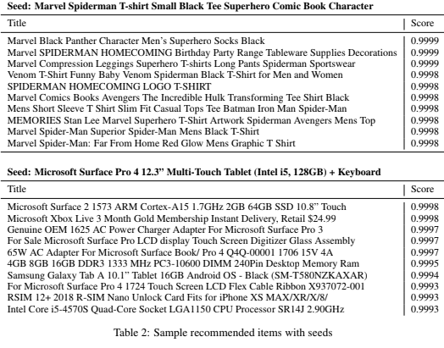
Experimental Results :
The recommended item span a
wide range of categories including
tablets, digital membership,
electronic accessories and computer
hardware.
Most recommended items are T-shirts, paired with clothing accessories and tableware decoration, all having marvel as theme.

Slide 6
Conclusion:
BERT model for the task of item-based recommendations.
Title tokens as content.
Token embeddings for cold start problem.
Superiority of our model.
Learning relationships between items .

Slide 7


